Slide 1

Course Name :
Software Engineering
Course Code : 210253 Credit : 03 Examination Scheme:
Mid-Sem(Paper) : 30 Marks End-Sem(Paper) : 70 Marks

Slide 2

Unit 1
Introduction to Software Engineering and Software Process Models
Management

Slide 3

Syllabus
Software Engineering Fundamentals : Introduction to Software Engineering ,Nature of Software , Defining Software, Software Engineering Practice
Process Models : A Generic Process Model, defining a Framework Activity, Identifying a Task Set, Process Patterns, Process Assessment and Improvement
Prescriptive Process Models, The Waterfall Model, Incremental Process Models, Evolutionary Process Models, Concurrent Models, A Final Word on Evolutionary Processes. Unified Process, Agile software development: Agile methods, plan driven and agile development.

Slide 4
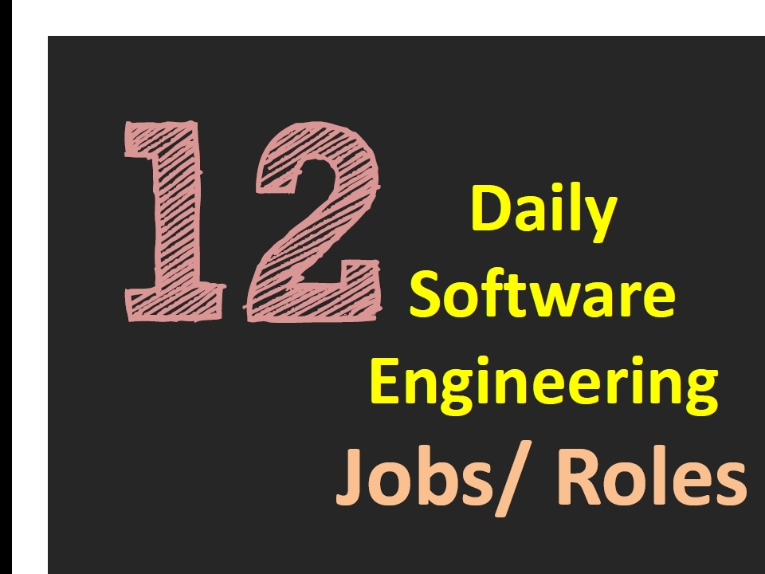

Slide 5
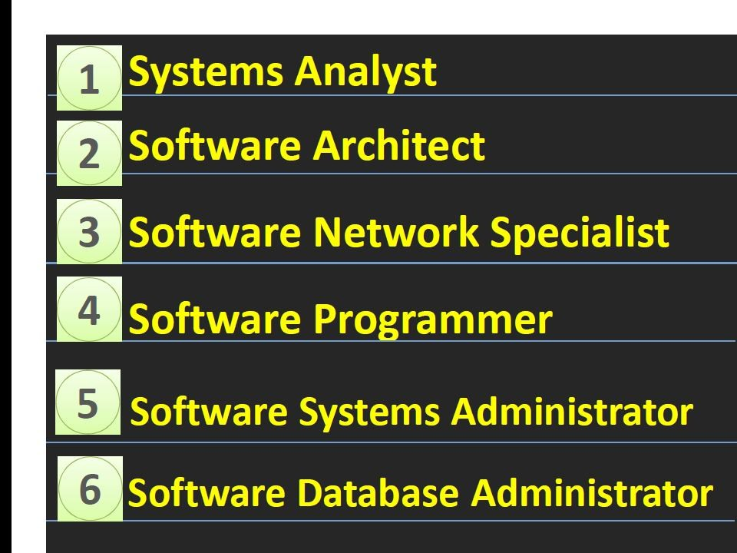

Slide 6
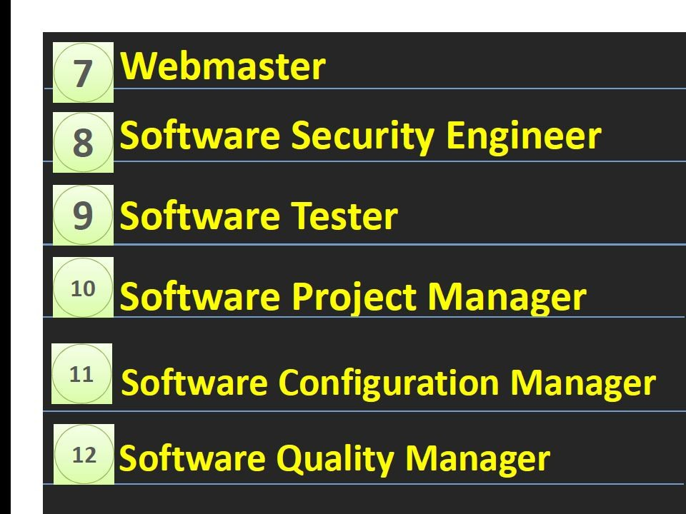

Slide 7
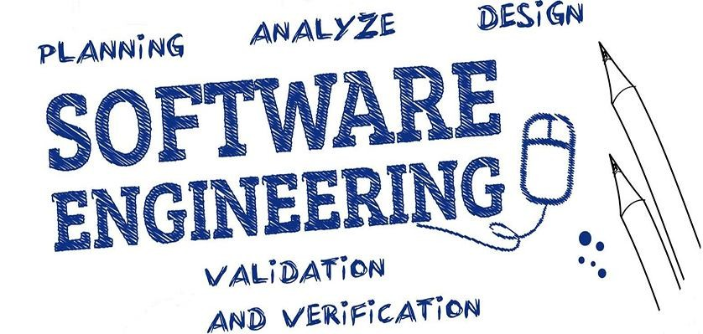
2
□ Unit- 1
□ Introduction to Software Engineering

Slide 8
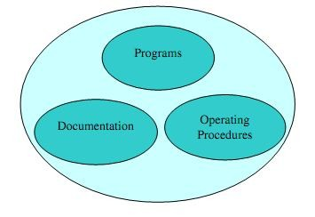
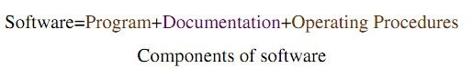
What is Software?
8

Slide 9
Software Domains 9
Sr. No. | Domains | Description | Examples
1 | System | Collection of Programs written to service other programs | Compilers ,Editors , Drivers etc
2 | Application | Stand-alone programs that solve a specific business need. | VLC, MySQL
3 | Embedded | Embedded in Hardware to make it SMARTER | Keypad Control Calculator
4 | Scientific/ Engineering | Characterized by “Number Crunching Algorithms ” | CAD,CFD
5 | Webapps | Network Centric S/ w spans a wide array of applications. | Amazon, Flipkart
6 | Artificial Intelligence | Perform tasks requiring Human Intelligence, such as Visual Perception, Speech Recognition, | GTA ,FIFA , Biometric : Pattern Recognition
 |  | Decision-Making and

Slide 10
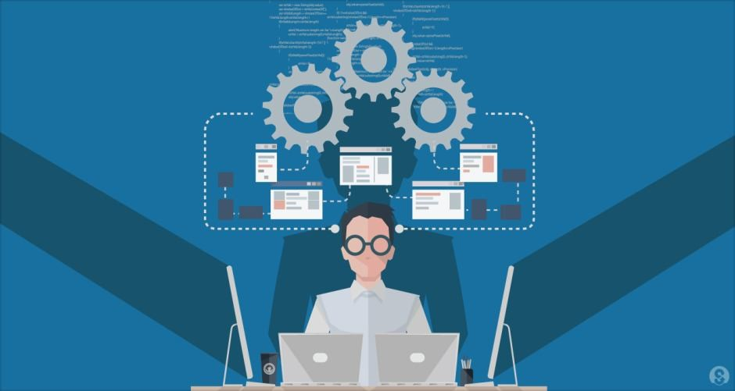
What is Software Engineering?
10
Is a Systematic and Disciplined approach towards development of software
Based on nature of problems Various tools and Technologies are applied to develop Quality Software.

Slide 11
Software Characteristics
11
Software is Engineered, Not Manufactured
Software Does not Wear Out
They are Custom Built rather than being assembled

Slide 12
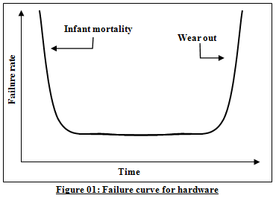
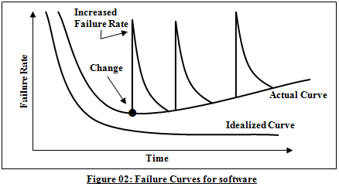
SOFWARE DOESN’T Wear Out ,But It Does Deteriorate..
12

Slide 13
Cost to fix an error increases as it is found later and later in the software lifecycle.
Relative costs to fix errors
80
70
60
Cost
50
40
30
20
10
0
Requirements
Design
Implementation
Testing
Maintenance
ni

Slide 14

Software Myths (Management Level)
Myths | Reality
Addition of more software specialists those with higher skills and longer experience may bring the schedule back on the track! | Unfortunately, that may further delay the schedule
Management may be confident about the state of the art and development tools company have | But the Latest Hardware configuration will not help in producing high Quality software
There is a Book that contain Standards and procedures for developing Software | Does it contain Modern engineering Practices? Does it Focus on Quality? Is it foolproof?

Slide 15
Software Myths (Customer Level)
Myths | Reality
A general statement is sufficient to get started with the development of software. No need to mention requirements | If we do so, we are heading towards a disaster
Project Requirement continuously changes but can be easily accommodated in software | If the Changes are requested in earlier stages of software then can be easily carried out but if requested in later stages Cost of change is rapidly increases
Software is easy to change. | The reality is totally different

Slide 16
Software Myths (Practitioner Level)
Myths | Reality
Once we write the program and get it work, our job is done | Usually, the problems just begin
Until I get the Program running , I have no way of assessing quality | However, quality assessment techniques should be used through out the software development life cycle
When the project is Successfully Delivered, Product is only running program. | It is just a small part of software but it also include Documentation, Help Files and Guidelines for handling software.

Slide 17
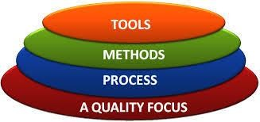
Software Engineering Layard Technology…
Provides Automated / Semi- Automated Support for process & Methods
provide the technical way for building software
1. Communication 2. Requirement Analysis
3. Analysis & Design 4. Implementation
5. Testing
Glue that holds the technology layers together and enables rational and timely development of computer software
The Degree of Goodness
1. Correctness 2. Maintainability 3. Integrity
4. Usability

Slide 18

Software Engineering Practice

Slide 19
The Essence of Practice
Understand the problem (communication and analysis).
Plan a solution (modeling and software design).
Carry out the plan (code generation).
Examine the result for accuracy (testing and quality assurance).

Slide 20
Software Engineering Principles

Slide 21
David Hooker [Hoo96] has proposed seven principles that focus on software engineering practice as a whole. They are reproduced in the following paragraphs:

Slide 22
1. The First Principle: The Reason It All Exists
✓
A software system exists for one reason: to provide value to its users. All decisions should be made with this in mind.

Slide 23
2. The Second Principle: KISS (Keep It Simple, Stupid!)
✓
All design should be as simple as possible.
✓
This facilitates having a more easily understood and easily maintained system.

Slide 24
3. The Third Principle: Maintain the Vision
✓
A clear vision is essential to the success of a software project .

Slide 25
4. The Fourth Principle: What You Produce, Others Will Consume
✓
So, always specify, design, and implement knowing someone else will have to understand what you are doing.
Someone may have to debug the code you write, and that makes them a user of your code. Making their job easier adds value to the system.

Slide 26
5. The Fifth Principle: Be Open to the Future
✓
A system with a long lifetime has more value. In today’s computing environments, where specifications change on a moment’s notice and hardware platforms are obsolete just a few months old, software lifetimes are typically measured in months instead of years.

Slide 27
6. The Sixth Principle: Plan Ahead for Reuse
✓
Reuse saves time and effort. Achieving a high level of reuse is arguably the hardest goal to accomplish in developing a software system.
✓
The reuse of code and designs has been proclaimed as a major benefit of using object-oriented technologies.

Slide 28
7. The Seventh principle: Think!
✓
When you think about something, you are more likely to do it right. You also gain knowledge about how to do it right again.
✓
If you do think about something and still do it wrong, it becomes a valuable experience.

Slide 29
Software Process
A process is a collection of activities, actions and tasks that are performed when some work product is to be created.
it is an adaptable approach that enables the people doing the work to pick and choose the appropriate set of work actions and tasks.
Purpose of process is to deliver software in a timely manner and with sufficient quality to satisfy those who have sponsored its creation and those who will use it.

Slide 30
Process framework
A Process framework establishes the foundation for a complete software engineering process by identifying a small number of framework activities that are applicable to all software projects, regardless of their size or complexity.
In addition, the process framework encompasses a set of umbrella activities that are applicable across the entire software process.
A generic process framework for software engineering encompasses five activities

Slide 31
Generic Process Activities are:
Communication
Planning
Modeling
Construction
Deployment

Slide 32
Generic Process Model

Slide 33
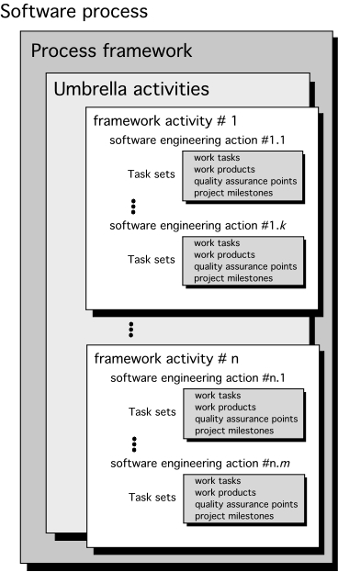

Slide 34
Umbrella Activities
Umbrella Activity Occur through out the process .
It Focus on progress, quality, change, and risk. The Various Activities are
Software project tracking and control: assess progress against the plan and take actions to maintain the schedule.
Risk management: assesses risks that may affect the outcome and quality.
Software quality assurance: defines and conduct activities to ensure quality.
Formal Technical reviews: assesses work products to uncover and remove errors before going to the next activity.
Measurement: define and collects process, project, and product measures to ensure stakeholder ’s needs are met.

Slide 35
Umbrella Activities
Software Configuration Management: It Manages the effect of changes throughout the process.
Reusability Measurement: It Define the criteria for product Reuse.
Work product preparation and Production: It Includes Activities require to create documents.

Slide 36
Process Flow

Slide 37
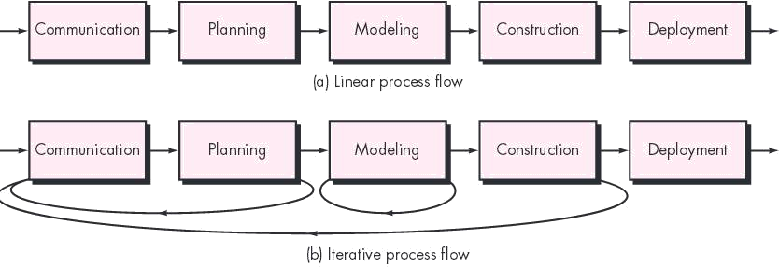

Slide 38
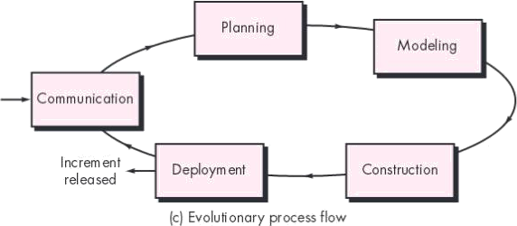

Slide 39
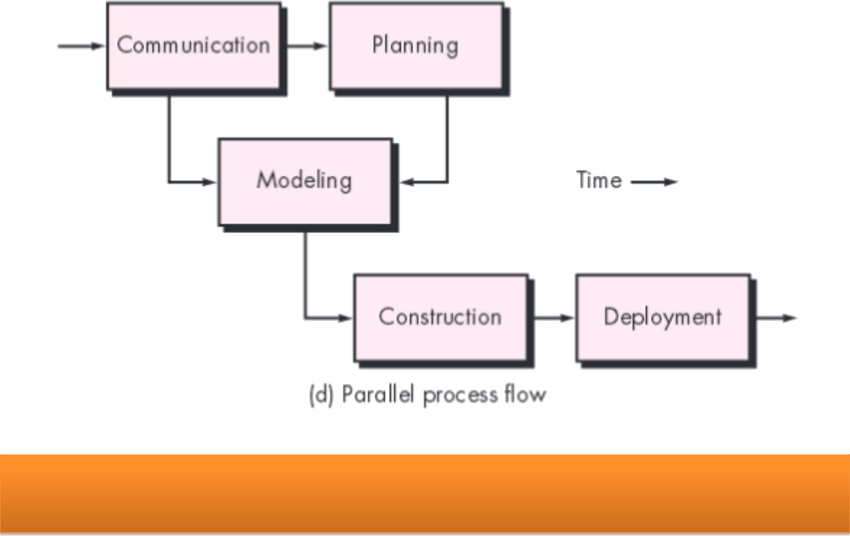

Slide 40
Process Models
Process Model
Perspective Process Model
Specialized Process Model
Waterfall Model
Incremental Model
Evolutionary Model
Incremental
Prototyping Model
V Model
RAD
Model
Spiral Model
Concurrent
Model
Prepared By: Prof. V. K. Wani

Slide 41
Prescriptive Process Models

Slide 42
✓
We call them as “Prescriptive” because they prescribe a set of process elements—framework activities, software engineering actions, tasks, work products, quality assurance, and change control mechanisms for each project.
✓
Each process model also prescribes a process flow (also called a work flow )—that is, the manner in which the process elements are interrelated to one another.

Slide 43

The Waterfall Model

Slide 44
✓
The waterfall model, sometimes called the classic life cycle.
It suggests a systematic, sequential approach to software development that begins with customer specification of requirements and progresses through planning, modeling, construction, and deployment, culminating in ongoing support of the completed software .

Slide 45
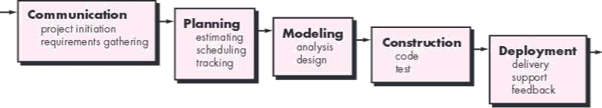
The Waterfall Model

Slide 46
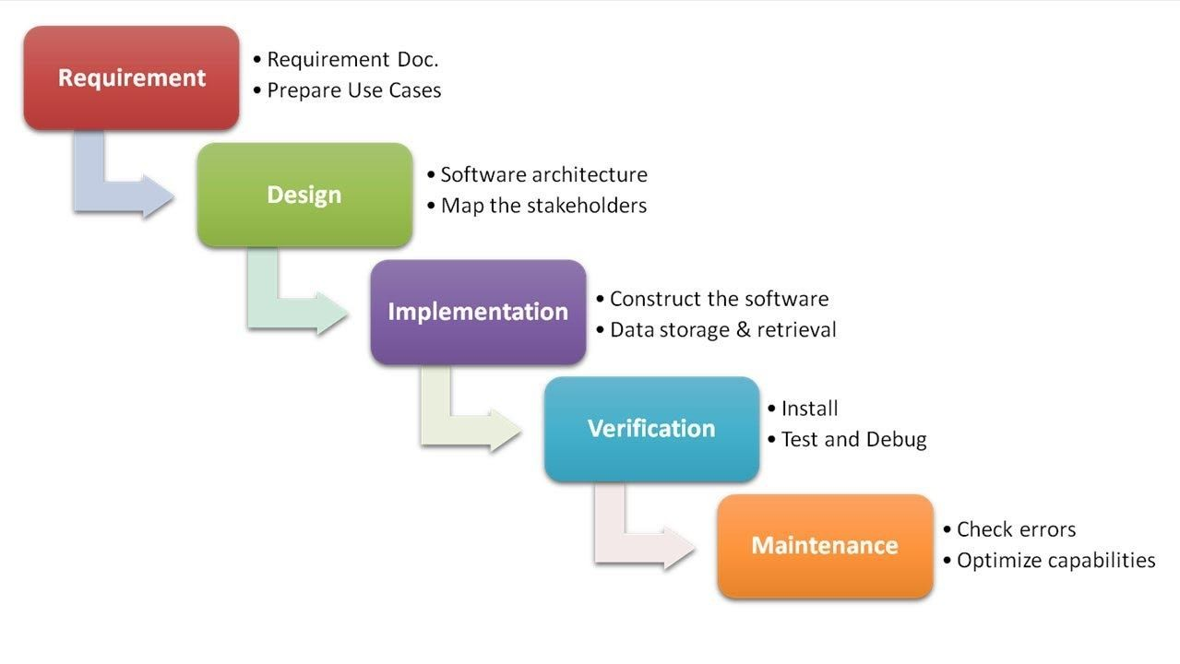
Waterfall Process Models
26

Slide 47
Waterfall Process Model
Advantages:
Very Simple & Easy to Understand
Is a Systematic & Sequential approach for S/ W Development
3.In this process each phase is processed and completed at one time so overlapping is
avoided.
4. Easy to manage as all requirement are very well understood in the beginning.
Disadvantages :
Problems in this model remains uncovered until testing.
The Biggest Drawback is Blocking State
3. According to model customer have to state requirement at beginning only which is
difficult for customer.
Customer get working version too late so not a realistic approach
Suitable only for small projects.

Slide 48
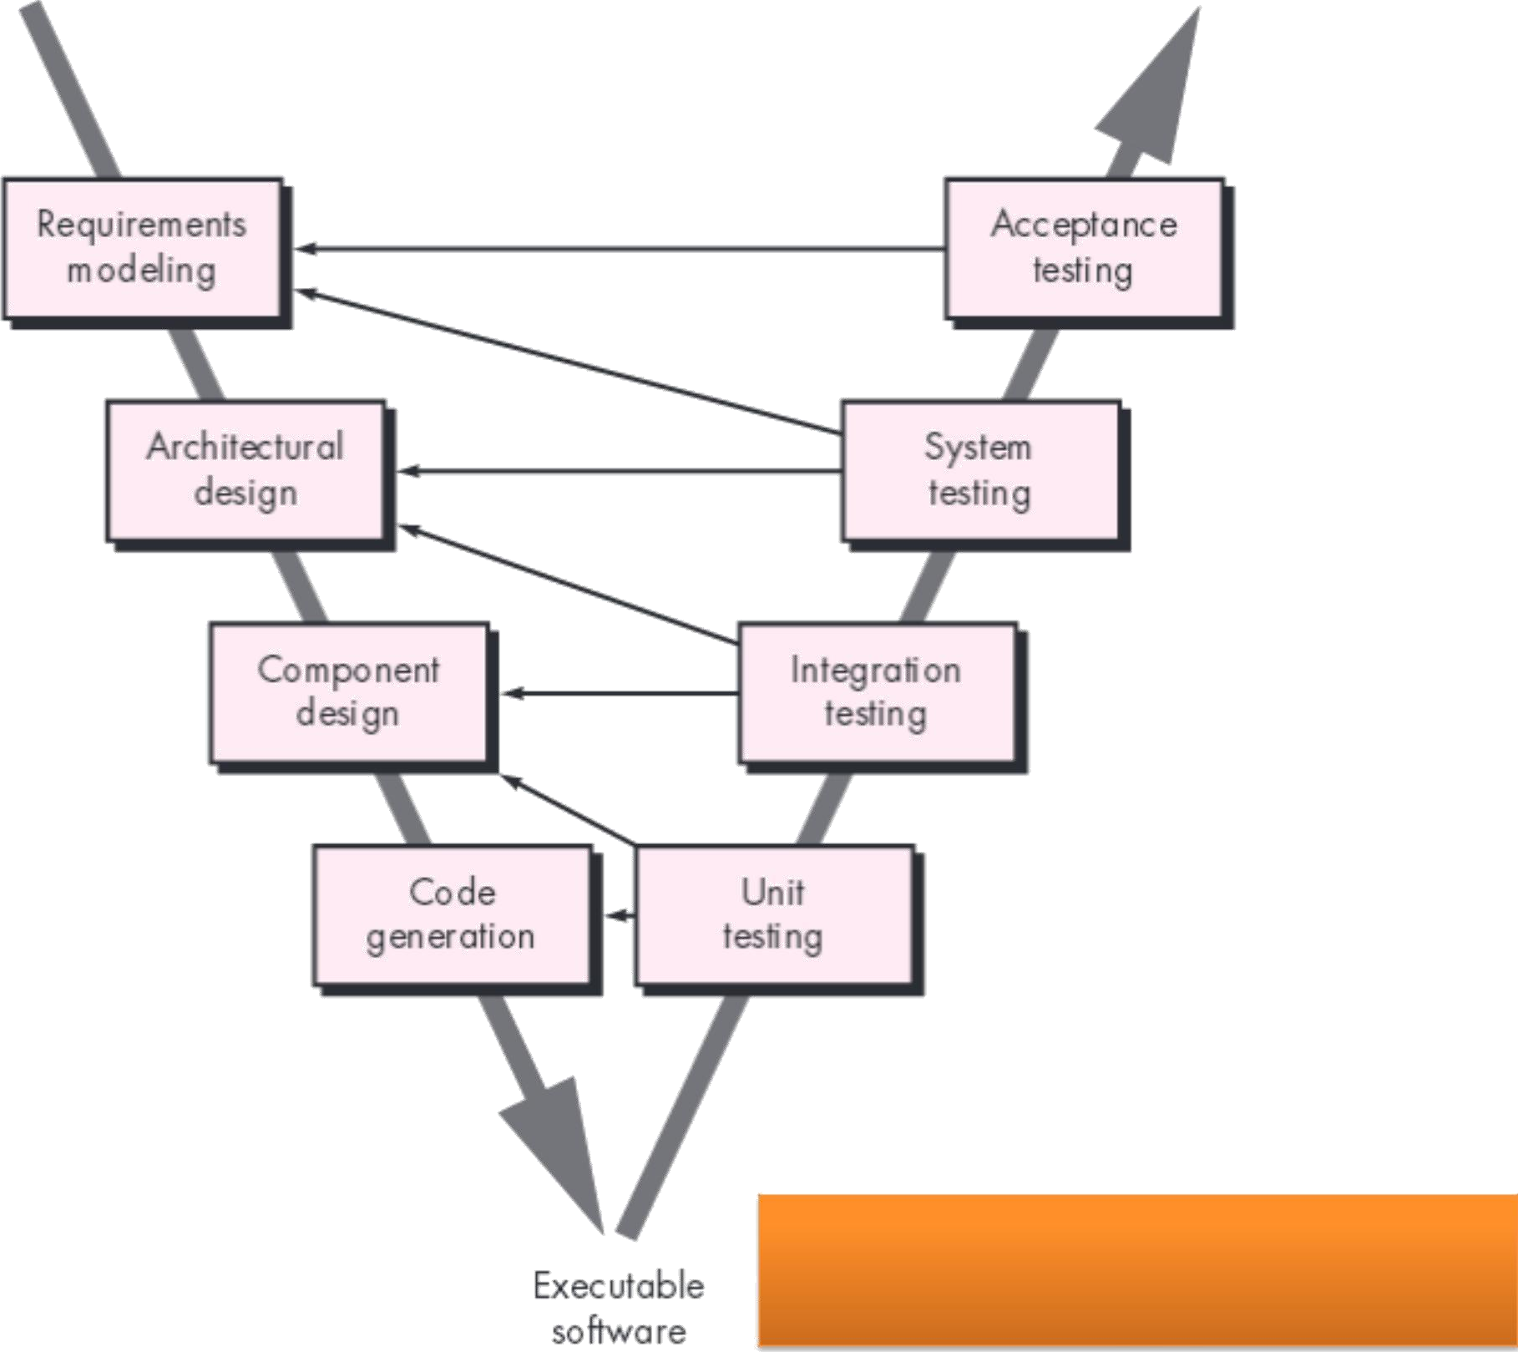
The V-model

Slide 49
✓
As a software team moves down the left side of the V, basic problem requirements are refined into progressively more detailed and technical representations of the problem and its solution.
✓
Once code has been generated, the team moves up the right side of the V, essentially performing a series of tests (quality assurance actions) that validate each of the models created as the team moved down the left side.
✓
In reality, there is no fundamental difference between the classic life cycle and the V-model.
✓
The V-model provides a way of visualizing how verification and validation actions are applied to earlier engineering work.
✓
The waterfall model is the oldest paradigm for software engineering.

Slide 50
V Model
Advantages
Progress goes in very systematic way.
Best suitable for small and medium size projects.
Testing starts from requirement phase.
Easy to keep track on progress.
Disadvantages
Not suitable for bigger and complex projects
Not a good option If Requirement changes frequently.
The client sees the only final project, not intermediate modules.
No scope for risk management

Slide 51
Incremental Process Model
This Model Helps to implement limited set of customer requirement quickly and Delivered to customer
The Modified and Remaining requirements are implemented step by step
The Overall Functionalities are split to smaller modules and then the modules are quickly developed and delivered.
Types of Incremental Process Model
The Increment Model
The RAD Model

Slide 52
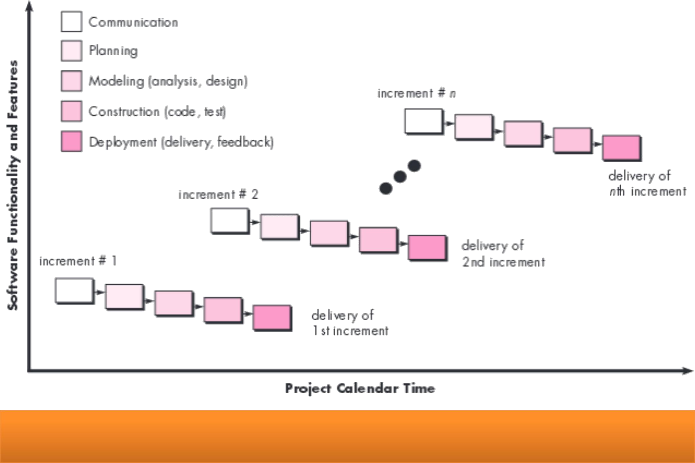
The Incremental Model

Slide 53
The Increment Model Cont…
Combines elements of waterfall model in iterative manner.
assist stakeholders to better understand what is to be built
Series of released called increments that progressively more functionality.
Eg. Word processing system.
First increment is core product that is opened for customer to use.
Early increments are stripes down version of final product
provides

Slide 54
The Increment Model Cont…
Advantages
The Model can be used with small Development Team
The initial Delivery of Product is Faster
The Customer Can Respond to Functionality after each increment
Disadvantages
The Cost of Final product may be increased
After each increment customer may demand new requirement which may cause problem to existing System
It Require Clear & Complete planning before the system Is broken in to increments

Slide 55
The RAD Model
Rapid Action Development is High Speed Adoption of Waterfall Model.
Initial activity start with communication between customer and developer.
Depending upon requirements the team are assigned work.
At last work product of every Team is integrated to form a product as whole.

Slide 56
The RAD Model Cont…
35
Team # n
M o d e l in g
bus ines s m odeling dat a m odeling
proc ess m odeling
Co m m u n icat io n
Team # 2
Mo d el ing
b u si n e ss m o d e l in g
C o n s t ru c t io n
com ponent reus e
aut om at ic code generat ion
t es t ing
d a t a m o d e l in g
p ro ce ss m o d e l i n g
Plan n in g
Team # 1
Co nst ruct io n
co m p o n e n t re u se a u t o m a t i c co d e
g e n e ra t io n t e st in g
De p lo ym e nt
int egrat ion deliv ery
feedback
Mod e lin g
business modeling dat a modeling
process modeling
Con st ru ct ion
component reuse
aut omat ic code
generat ion t est ing
6 0 - 9 0 d ays

Slide 57
The RAD Model Cont…
Advantages
Product can be developed within short time period
Increase Reusability,
Minimal Code Writing
Resolve Integration Issues.
Disadvantages
Sufficient manpower to create team
All team should work in parallel
Not appropriate when technical risk is high
Only for large products
Reduce Scalability
Reduced Features

Slide 58
Evolutionary Models
They are basically iterative Once the requirements are analyzed, they pass through a series of iterations till the complete software is developed.
The evolutionary models mainly support the programmer to develop the complete version of a software., after each release, based on the review given by the reviewers
Types of Evolutionary Models
The Prototyping Model
The Spiral Model
Concurrent Development Model

Slide 59
The Prototyping Model
The basic idea in Prototype model is that instead of freezing the requirements before a design or coding can proceed,
A prototype is built to understand the Clear requirements .
This prototype is developed based on the currently known requirements .
Compelling need to provide a limited set of software functionally to users quickly and then refine and expand.

Slide 60
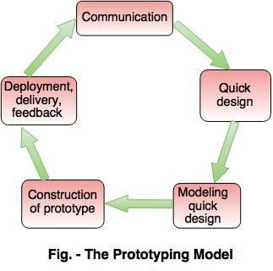
The Prototyping Model

Slide 61
The Prototyping Model
Advantages:
It makes requirement more Clear and System more Transparent
Disadvantages:
The Quality may get compromised because of prototyping quickly

Slide 62
Spiral Model

Slide 63
Spiral Model
Spiral Model is a risk-driven software development process model.
It is a combination of waterfall model and iterative model.
Spiral Model helps to adopt software development elements of multiple process models for the software project based on unique risk patterns ensuring efficient development process.

Slide 64
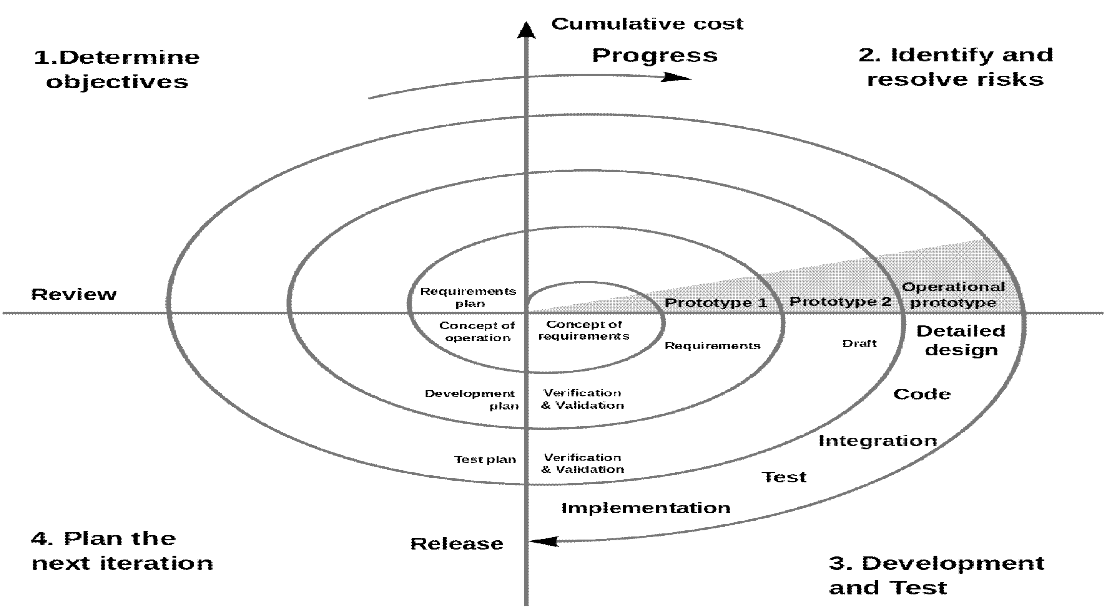

Slide 65
Spiral Model Cont…
Have the iterative nature of prototyping with the controlled and systematic aspects of waterfall model
Provides the potential for rapid development of increasingly more complete versions of the software
This model is divided in to set of framework activities, Each activity represent one segment of spiral .
Can be adopted to apply throughout the entire life cycle of an application from concept development to maintenance

Slide 66
Spiral Model Cont…
Advantages
Project monitoring is very effective and easy
It reduces the risk in software development
Risk management is in-built feature of the model
Disadvantages
Cost of approach is high
Not suitable for low risk approach
Rules and protocol must be followed strictly in the approach.

Slide 67
Concurrent Model

Slide 68
✓
The concurrent development model, sometimes called
concurrent engineering, allows a software team to represent iterative and concurrent elements of any of the process models.
✓
The activity modeling may be in any one of the states noted at any given time.
✓
Software engineering activities exist concurrently but reside in different states.

Slide 69
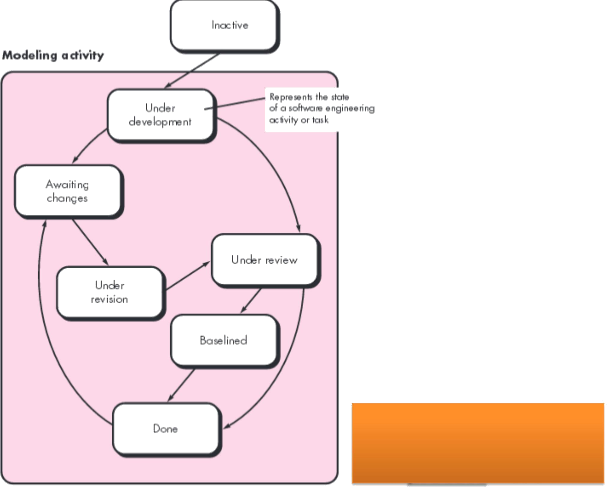
Concurrent process model

Slide 70
For example, early in a project the communication activity (not shown in the figure) has completed its first iteration and exists in the awaiting changes state.
✓
✓
The modeling activity (which existed in the inactive state while initial communication was completed, now makes a transition into the under development state.
✓
If, however, the customer indicates that changes in requirements must be made, the modeling activity moves from the under development state into the awaiting changes state.
✓
Concurrent modeling defines a series of events that will trigger transitions from state to state for each of the software engineering activities, actions, or tasks.
✓
This generates the event analysis model correction, which will trigger the requirements analysis action from the done state into the awaiting changes state.

Slide 71
Concurrent Model
It is applicable to all types of software development
Provides an accurate picture of the current state of a project
It cab represent diagrammatically a series of tasks, framework activities, and their associated states
Events generated at one point the process network trigger transitions among the states
The Above diagram represent the one element of concurrent process model.

Slide 72
Concurrent Model
Advantages
applicable to all types of software development It reduces the risk in software development
Provides an accurate picture of the current state of a project
Easy to Use and Understand

Slide 73
Unified Process

Slide 74
The Unified Process recognizes the importance of customer communication and streamlined methods for describing the customer’s view of a system.
✓
✓
“Unified method” that would combine the best features of each of their individual object-oriented analysis and design methods.
✓
The result was UML—a unified modeling language that contains a robust notation for the modeling and development of object- oriented systems.

Slide 75
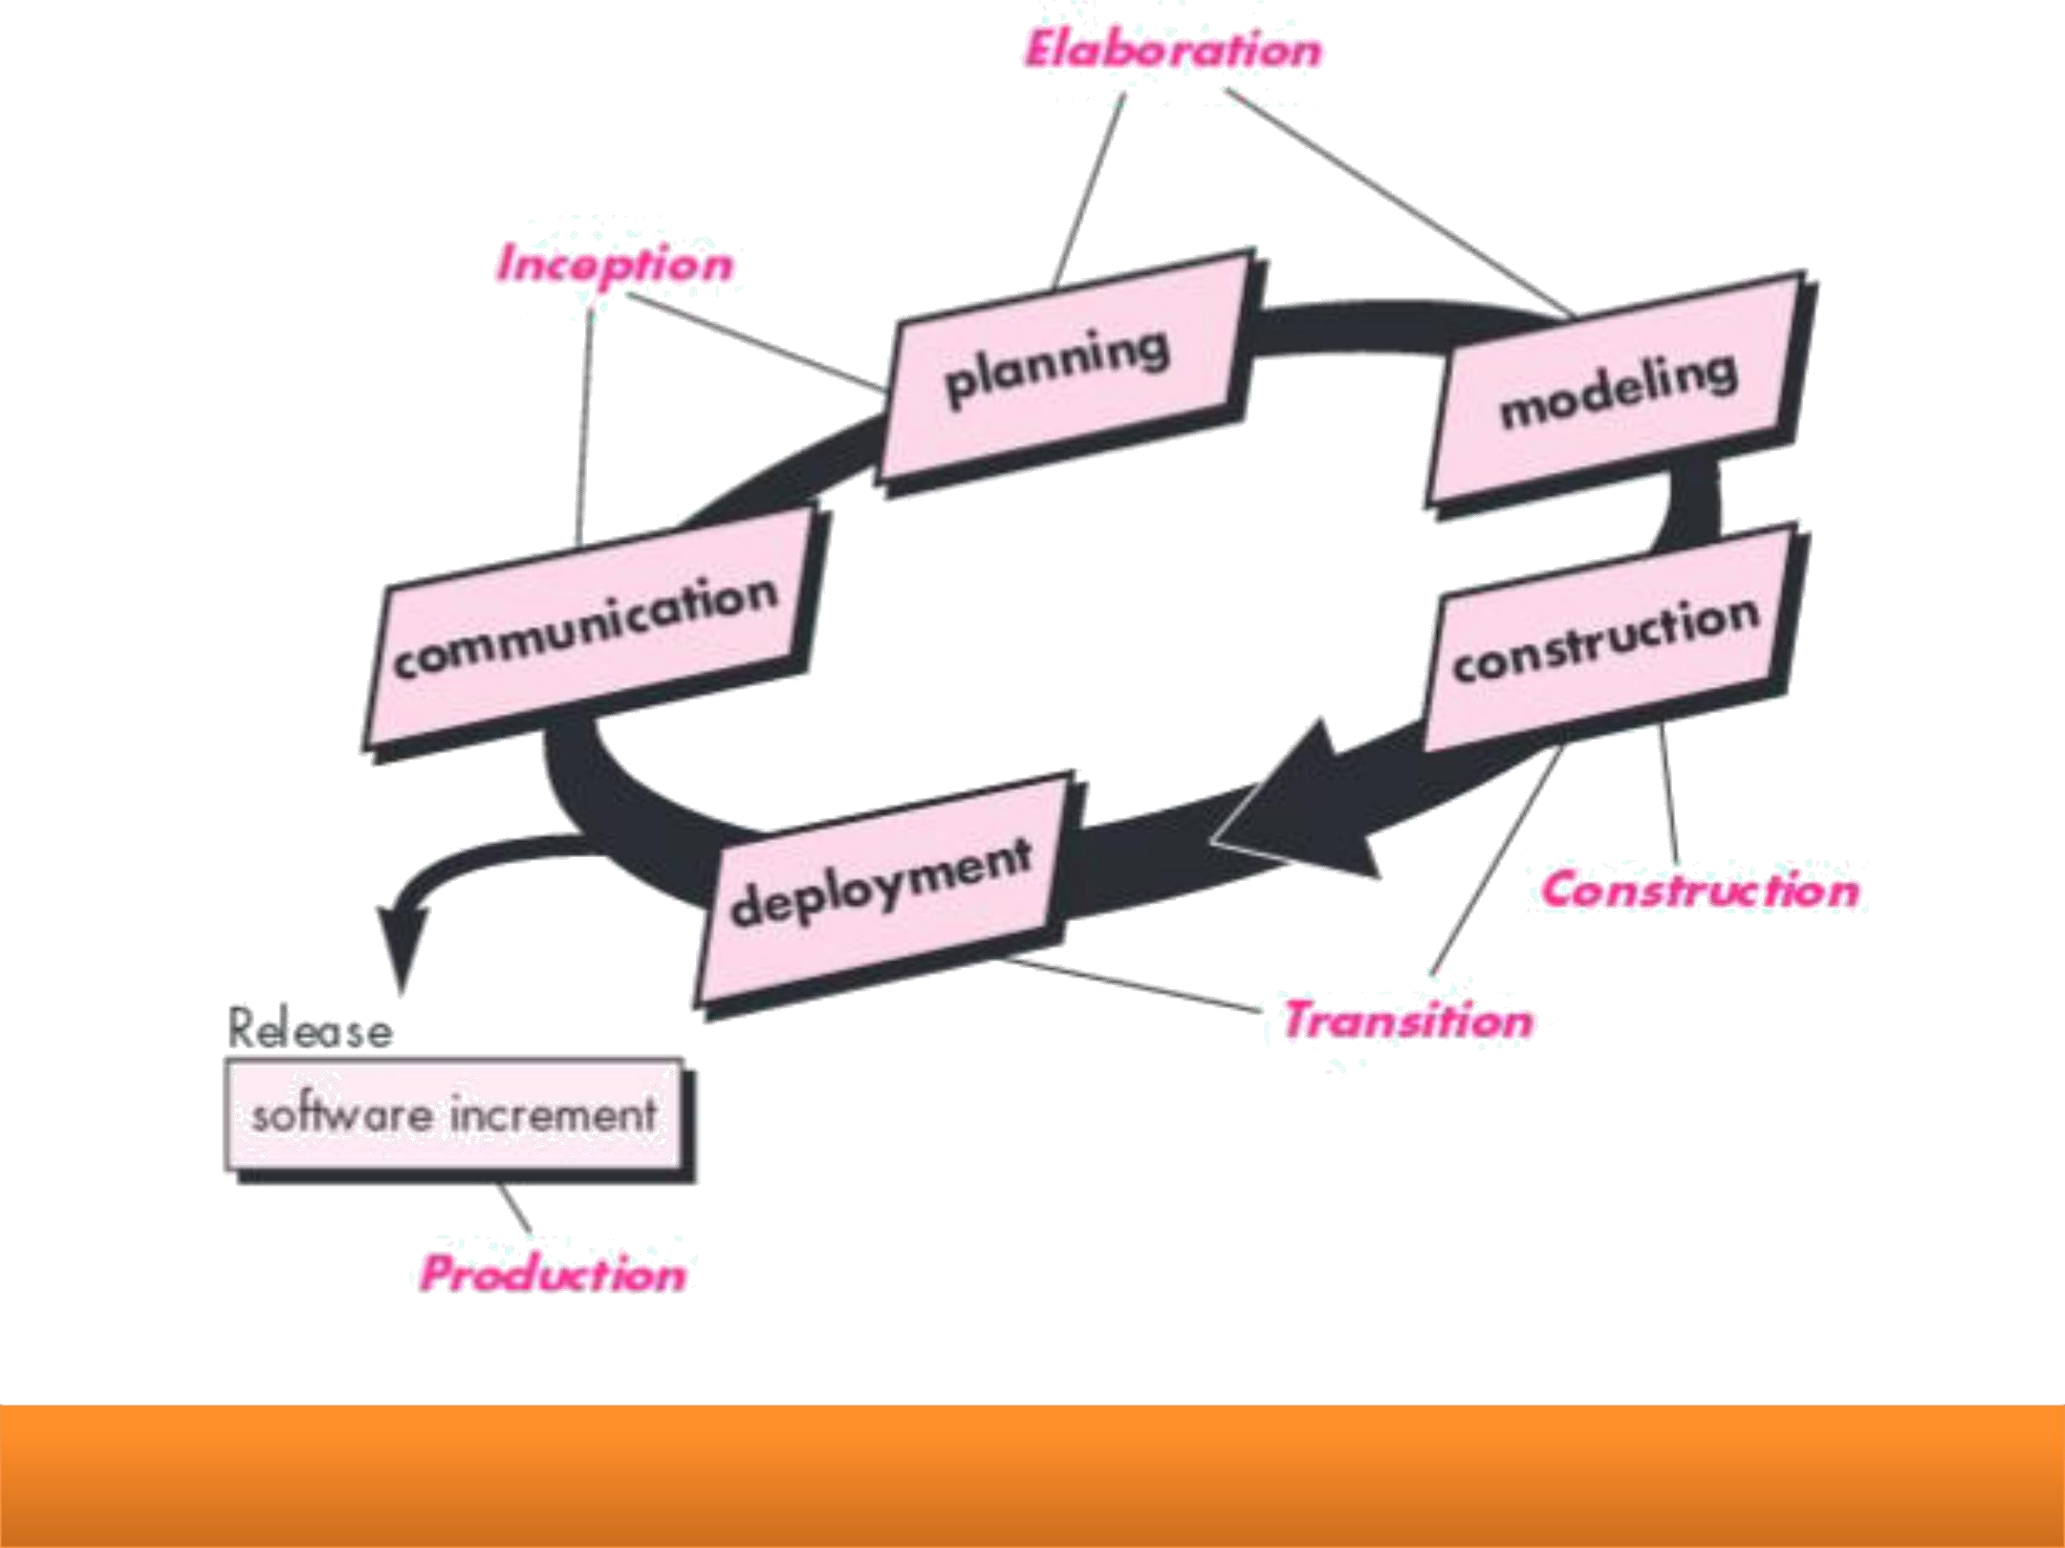
The Unified Process

Slide 76
Phases of the Unified Process
✓
The Inception phase of the UP encompasses both customer communication and planning activities.
✓
By collaborating with stakeholders, business requirements for the software are identified; a rough architecture for the system is proposed; and a plan for the iterative, incremental nature of the ensuing project is developed.
✓
Architecture at this point is nothing more than a tentative outline of major subsystems and the function and features that populate them. Later, the architecture will be refined and expanded into a set of models that will represent different views of the system.
✓
The Elaboration phase encompasses the communication and modeling activities of the generic process model.

Slide 77
✓
Elaboration refines and expands the preliminary use cases that were developed as part of the inception phase and expands the architectural representation.
✓
The architectural baseline demonstrates the viability of the architecture but does not provide all features and functions required to use the system.
✓
The Construction phase of the UP is identical to the construction activity defined for the generic software process.
✓
Using the architectural model as input, the construction phase develops or acquires the software components that will make each use case operational for end users.
✓
To accomplish this, requirements and design models that were started during the elaboration phase are completed to reflect the final version of the software increment.

Slide 78
The Transition phase of the UP encompasses the latter stages of the generic construction activity and the first part of the generic deployment (delivery and feedback) activity.
✓
✓
Software is given to end users for beta testing and user feedback reports both defects and necessary changes.
✓
In addition, the software team creates the necessary support information (e.g., user manuals, troubleshooting guides, installation procedures) that is required for the release.
✓
The Production phase of the UP coincides with the deployment activity of the generic process.
✓
During this phase, the ongoing use of the software is monitored, support for the operating environment (infrastructure) is provided, and defect reports and requests for changes are submitted and evaluated.

Slide 79
Specialized Process Model
Types of Specialized Process model
Component-based development
Formal methods model
Aspect-oriented software development

Slide 80
Process Patterns

Slide 81
PROCESS PATTERNS
The software process can be defined as a collection of patterns that define a set of activities, actions, work tasks, work products and/or related behaviors required to develop computer software. Patterns can be defined at any level of abstraction.
In some cases, a pattern might be used to describe a complete process (e.g., prototyping).
In other situations, patterns can be used to describe an important framework activity (e.g., planning) or a task within framework activity (e.g., project- estimating).
Ambler has proposed the following template for describing a process pattern:

Slide 82
Pattern Name. The pattern is given a meaningful name that describes its functions within the software process (e.g., customer-communication). Intent. The objective of the pattern is described briefly. For example, the intent of customer-communication is “to establish a collaborative relationship with the customer in an effort to define project scope, business requirements, and other projects constraints”. Type. The pattern type is specified. Ambler suggests three types:

Slide 83
Task pattern define a software engineering action or work task that is part of the process and relevant to successful software engineering practice (e.g., requirements gathering is a task pattern). • Stage patterns represent a framework activity for the process. Since a framework activity encompasses multiple work tasks, a stage pattern incorporates multiple task patterns that are relevant to the stage. An example of a stage pattern might be communication. This pattern would incorporate the task pattern requirements gathering and others. • Phase patterns define the sequence of framework activities is iterative in nature. An example of a phase pattern might be a spiral model or prototyping.

Slide 84
Initial context. The conditions under which the pattern applies are described. Prior to the initiation of the pattern, we ask
(1) what organizational team created activities have already occurred
(2) what is the entry state for the process? And
(3) what software engineering information or project information already exists? For example, the planning pattern (a stage pattern) requires that
(1) customers and software engineers have established a collaborative communication:
(2) successful completion of a number of task patterns (specified) for the customer-communication pattern has occurred: and
(3) project scope, basic business requirements, and project constraints are known.

Slide 85
An Example Process Pattern: The following abbreviated process pattern describes an approach that may be applicable when stakeholders have a general idea of what must be done, but are unsure of specific software requirements. Pattern name. Prototyping. Intent: The objective of the pattern is to build a model (a prototype) that can be assessed iteratively by stakeholders in an effort to identify or solidity software requirements. Type: Phase pattern.

Slide 86
Initial context: The following conditions must be met prior to the initiation of this pattern:
( 1) stakeholders have been identified;
(2) a mode of communication between stakeholders and the software team has been established;
(3) the overriding problem to be solved has been identified by stakeholders:
(4) an initial understanding of project scope, basic business requirements, and project constraints has been developed. Problem: Requirements are hazy or nonexistent, yet there is clear recognition that there is a problem, and the problem must be addressed with a software solution. Stakeholders are unsure of what they want; that is, they cannot describe software requirements in any detail.

Slide 87
Solutions: A description of the prototype that identifies basic requirements (e.g., modes of interaction, computational features, processing functions) is approved by stakeholders. Following this,
(1) the prototype may evolve through a series of increments to become the production software or
(2) the prototype may be discarded and the production software built using some other process pattern. Related Patterns: The following patterns are related to this pattern: customer-communication; iterative design; iterative development, customer assessment; requirement extraction. Known uses/examples: Prototyping is recommended when requirements are uncertain.

Slide 88
PROCESS ASSESSMENT
The process assessment is to ensure that it meets a set of basic process criteria that have been shown to be essential for a successful software engineering.
A number of different approaches to software process assessment have been proposed over the past few decades:

Slide 89
Standard CMMI Assessment Method for Process Improvement (SCAMPI) provides a five—step process assessment model that incorporates initiating, diagnosing, establishing, acting, and learning. The SCAMPI methods use the SEI CMMI as the basis for assessment. i. SPICE (ISO/IEC 15504) Software Process Improvement and Capability Determination (SPICE) Standard defines a set of requirements for software process assessment. The intent of the standard is to assist organization in developing an objective evaluation of the efficacy of any defined software process. ii. ISO9001: 2000 for Software is a generic standard that applies to any organization that wants to improve overall quality of the products, systems, or services that it provides. Therefore, the standard is directly applicable to software organizations and companies.
*The Capability Maturity Model Integration (CMMI) is a process and behavioral model that helps organizations streamline process improvement and encourage productive, efficient behaviors that decrease risks in software, product and service development.

Slide 90

Advanced Process Models & Tools
Agile software development

Slide 91
Agile model
Agile SDLC model is a combination of iterative and incremental process models with focus on process adaptability and customer satisfaction by rapid delivery of working software product.
Agile Methods break the product into small incremental builds. These builds are provided in iterations.

Slide 92
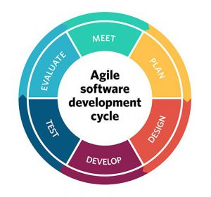
Agile SDLC

Slide 93
Agile software development
Agile software development refers to a group of software development methodologies based on iterative development, where requirements and solutions evolve through collaboration between self-organizing cross-functional teams.
Agile development refers to any development process that is aligned with the concepts of the Agile Manifesto. The Manifesto was developed by a group fourteen leading figures in the software industry, and reflects their experience of what approaches do and do not work for software development.

Slide 94
The Four Values of The Agile Manifesto
1. Individuals and Interactions Over Processes and Tools
2. Working Software Over Comprehensive Documentation
3. Customer Collaboration Over Contract Negotiation
4. Responding to Change Over Following a Plan

Slide 95
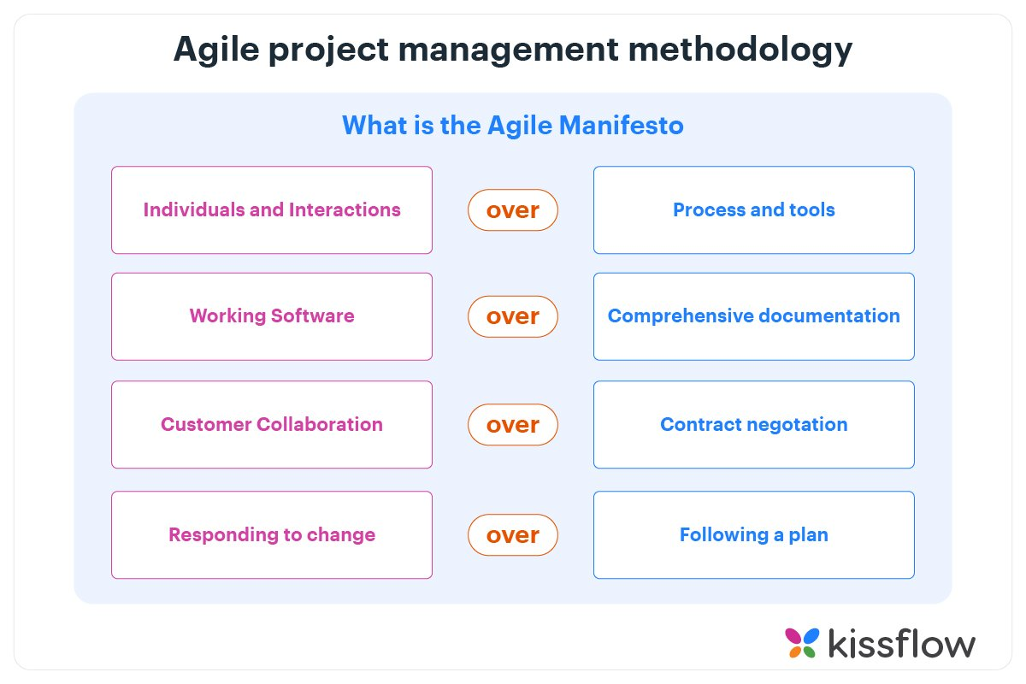

Slide 96
1. Customer Involvement :- Customers should be closely involved throughout the development process. Their role is provide and prioritize new system requirements and to evaluate the iterations of the system.
✓
Principles of Agile Methods :-
Incremental delivery :- The software is developed in increments with the customer specifying the requirements to be included in each increment.
People not process :- The skills of the development team should be recognized and exploited. Team members should be left to develop their own ways of working without prescriptive processes.
Embrace change :- Expect the system requirements to change and so design the system to accommodate these changes.
Maintain simplicity :- Focus on simplicity in both the software being developed and in the development process. Wherever possible, actively work to eliminate complexity from the system.

Slide 97
12 Principles of Agile Manifesto
Customer satisfaction through continuous delivery of the product
Divide large chunks of work into smaller and achievable tasks for quicker completion and easier integration of changes
Adhere to the decided timeframe for the delivery of a working product
All stakeholders must frequently collaborate to ensure that the project is going in the correct direction
Create a supportive environment to motivate team members and encouraging them to get the job done
Prefer face-to-face communication over other methods
Working software is the primary measure of progress
Try to maintain a constant pace of development.
Maintain the quality of the product by paying attention to technical details
Maintain simplicity
Promote self-organization in the team
Regularly reflect on your performance for continuous improvement

Slide 98
Plan-driven and agile development

Slide 99
✓
By contrast, a plan-driven approach to software engineering identifies separate stages in the software process with outputs associated with each stage.
✓
The outputs from one stage are used as a basis for planning the following process activity.
✓
Figure 3.2 shows the distinctions between plan-driven and agile approaches to system specification.
✓
Requirement Engineering = What your program should do ?
✓
Requirement Specification = How you plan to do it ?

Slide 100
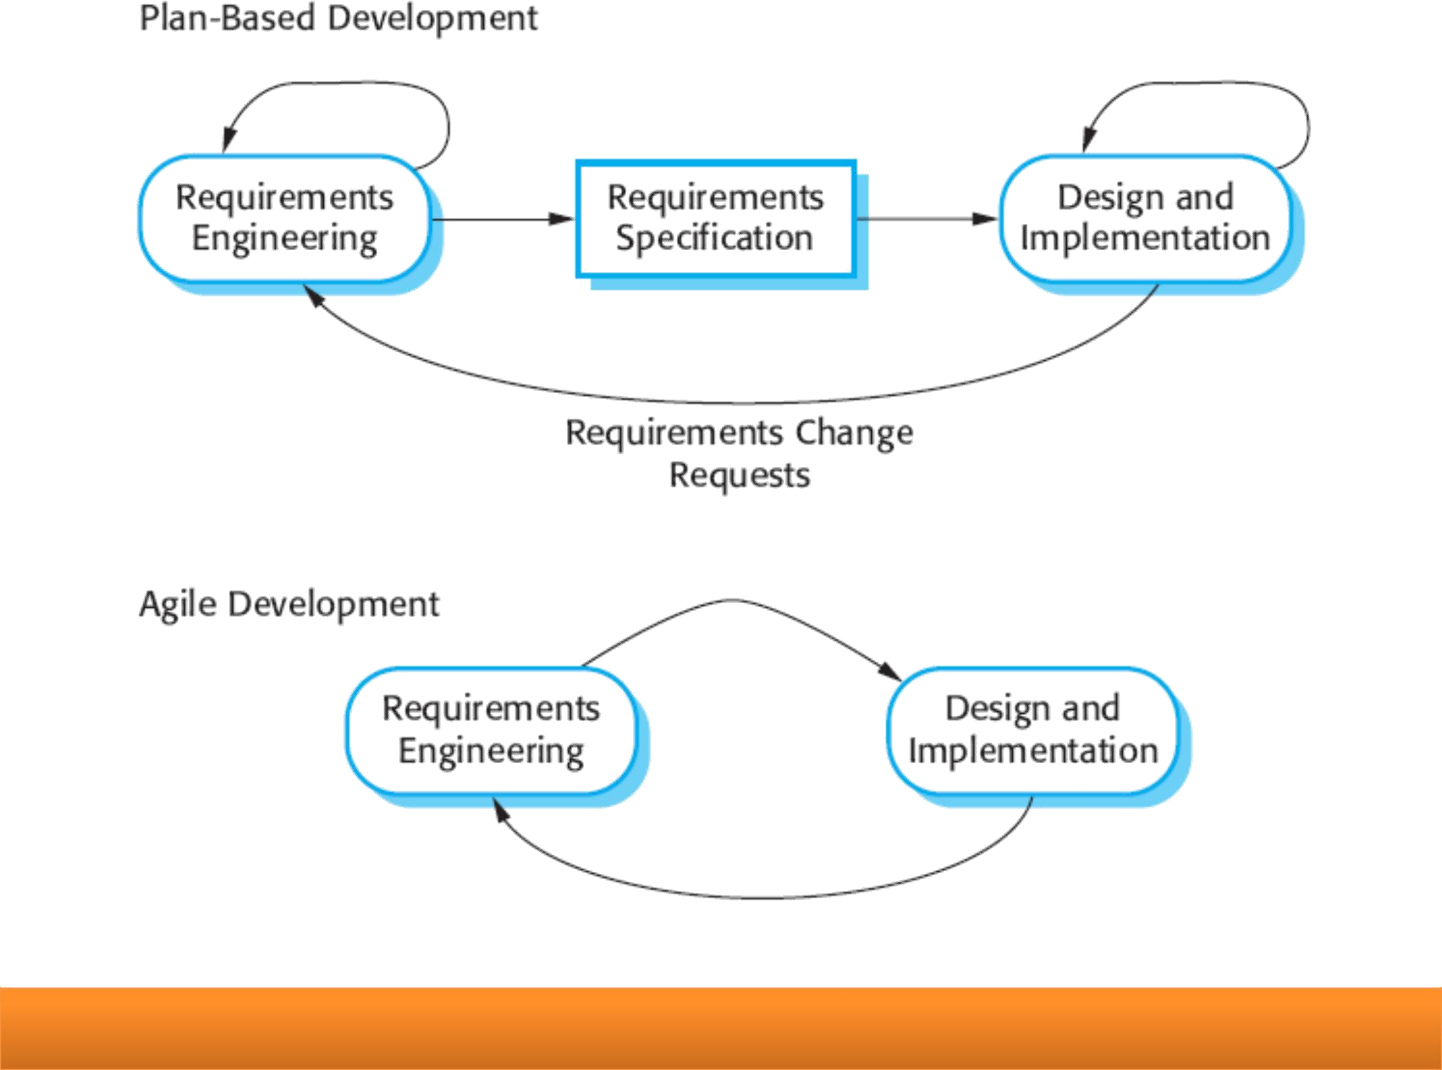
Plan-driven and agile specification

Slide 101
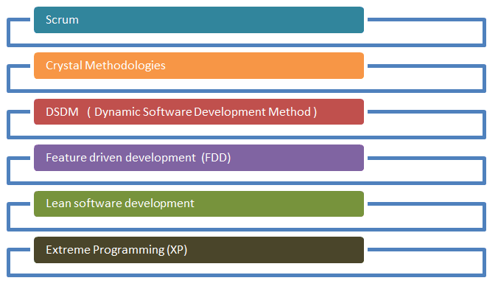
Agile process model

Slide 102
Scrum
SCRUM is an agile development method which concentrates specifically on how to manage tasks within a team-based development environment.
Basically, Scrum is derived from activity that occurs during a rugby match. Scrum believes in empowering the development team and advocates working in small teams (say- 7 to 9 members).
It consists of three roles, and their responsibilities are explained as follows:

Slide 103
Scrum Master
Master is responsible for setting up the team, sprint meeting and removes obstacles to progress
Product owner
The Product Owner creates product backlog, prioritizes the backlog and is responsible for the delivery of the functionality at each iteration
Scrum Team
Team manages its own work and organizes the work to complete the sprint or cycle

Slide 104
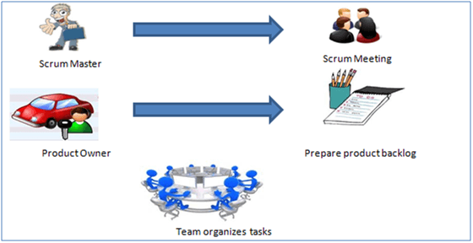

Slide 105
Process flow of Scrum Methodologies:
Each iteration of a scrum is known as Sprint
Product backlog is a list where all details are entered to get the end-product
During each Sprint, top user stories of Product backlog are selected and turned into Sprint backlog
Team works on the defined sprint backlog
Team checks for the daily work
At the end of the sprint, team delivers product functionality

Slide 106
eXtreme Programming (XP)
Extreme Programming technique is very helpful when there is constantly changing demands or requirements from the customers or when they are not sure about the functionality of the system.
It advocates frequent "releases" of the product in short development cycles, which inherently improves the productivity of the system and also introduces a checkpoint where any customer requirements can be easily implemented.
The XP develops software keeping customer in the target.

Slide 107
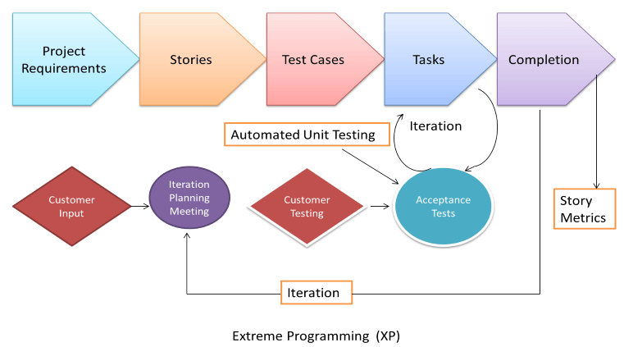

Slide 108
Business requirements are gathered in terms of stories. All those stories are stored in a place called the parking lot.
In this type of methodology, releases are based on the shorter cycles called Iterations with span of 14 days time period. Each iteration includes phases like coding, unit testing and system testing where at each phase some minor or major functionality will be built in the application.

Slide 109
Dynamic Software Development Method (DSDM)
DSDM is a Rapid Application Development (RAD) approach to software development and provides an agile project delivery framework.
The important aspect of DSDM is that the users are required to be involved actively, and the teams are given the power to make decisions.
Frequent delivery of product becomes the active focus with DSDM. The techniques used in DSDM are
Time Boxing
MoSCoW Rules
Prototyping

Slide 110
The DSDM project consists of 7 phases
Pre-project
Feasibility Study
Business Study
Functional Model Iteration
Design and build Iteration
Implementation
Post-project

Slide 111
Feature Driven Development (FDD)
This method is focused around "designing & building" features. Unlike other agile methods, FDD describes very specific and short phases of work that has to be accomplished separately per feature.
It includes domain walkthrough, design inspection, promote to build, code inspection and design.
FDD develops product keeping following things in the target

Slide 112
Domain object Modeling
Development by feature
Component/ Class Ownership
Feature Teams
Inspections
Configuration Management
Regular Builds
Visibility of progress and results

Slide 113
Agile Tools
JIRA
KANBAN

